Slide 1


BRAZIL
WORLD

Slide 2

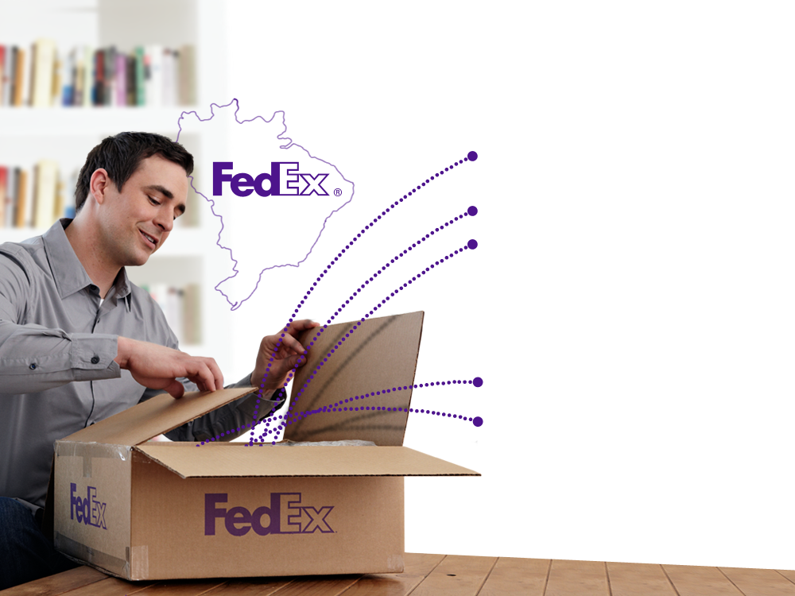


Contents
FedEx Globally
Our Brazil Footprint
Our capabilities in Brazil / Value Proposition
International Service
Freight Forwarding
Rapidão Cometa
Sales Structure
Questions
PRIVILEGED AND CONFIDENTIAL – DO NOT COPY

Slide 3




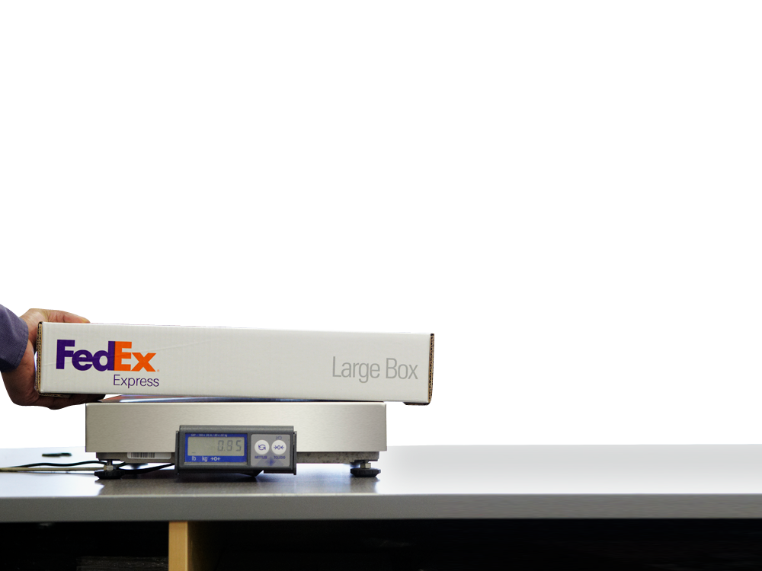
FedEx Express
The largest express transportation company in the world
Notes:
We also have FedEx Trade Networks and FedEx Supply Chain, very important partners within FedEx.

Slide 4












FedEx
Move
3.5 million Packages
(avg. daily volume)
11.5 million Pounds of freight
(avg. daily volume)
Via
> 90,000 Surface vehicles
> 42,280 Drop boxes
> 375 Airports
> 688 Aircraft
> 300,000 Team members
Serving
> 220 Countries and territories

Slide 5
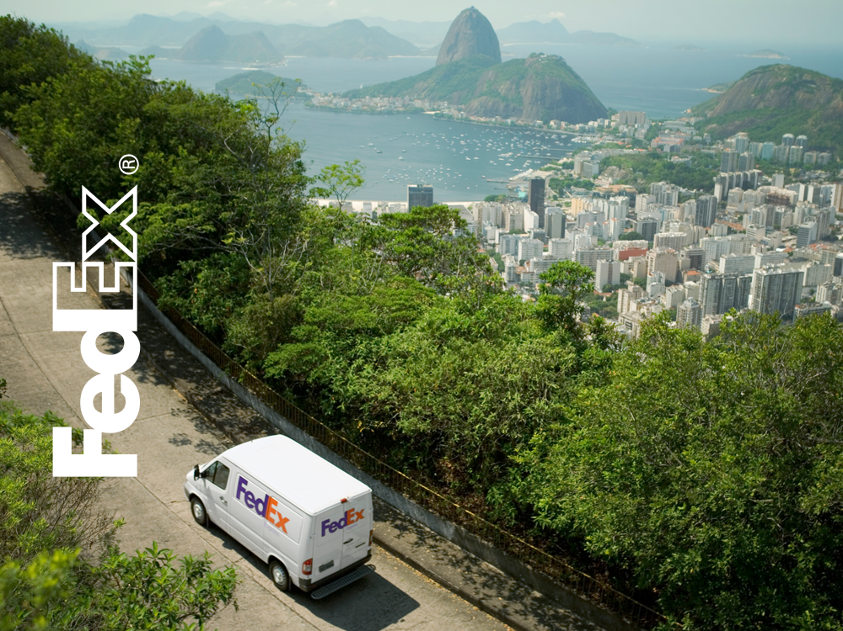
FOOTPRINT
CAPABILITIES

Slide 6

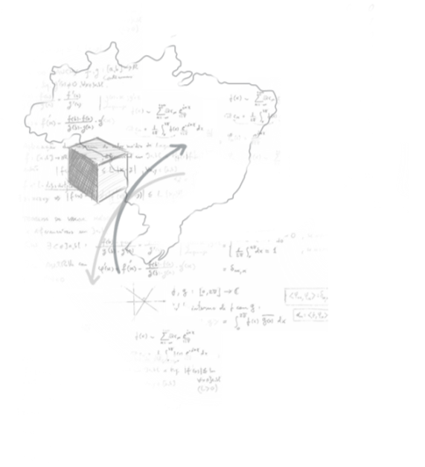


FedEx Brazil Key Strengths
FedEx has largest combined air and ground transportation infrastructure of any private sector company in Brazil
No other private sector transportation integrator in Brazil has an air-ground infrastructure that connects 96% of Brazil’s GDP and connects Brazil to a global network serving 220 countries and territories
No private sector company in Brazil has a larger domestic transportation and logistics infrastructure, combined with international flight operations, than FedEx
FedEx has the largest coverage in Brazil among all transportation companies
FedEx has the largest aircraft capacity operating in Brazil among integrators
Customized logistics solutions
State of the art automation tools for shipping, tracking and managing your account

Slide 7



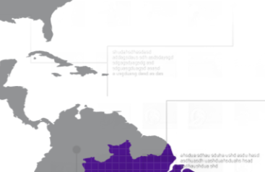


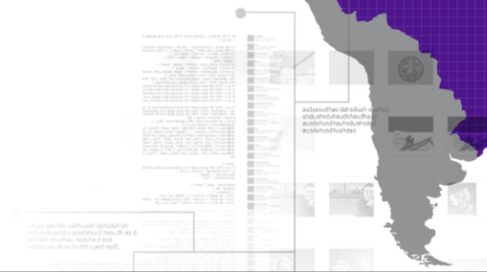
FedEx Brazil Fast Facts
Brazil Headquarters | São Paulo and Recife
Employees | Approximately 9,500 dedicated professionals
Operational Coverage | Domestic: More than 96% of Brazil´s GDP International: More than 220 countries
Sales Coverage | Most cities nationwide: More than 5,300 cities
Fleet | 2 dedicated aircrafts (MD-11 and B-727) More than 920 ground vehicles and trailers
Retail Network | More than 84 authorized shipping centers
Flight Gateway | VCP
Daily Flights | 5 flights per week to Memphis to connect to its global network; 5 flights per week to Buenos Aires
Warehouses | 700,000 m2
Ground | Approximately 50 branches 145 distribution points
Expansion | Rapidão Cometa acquisition in July 2012

Slide 8

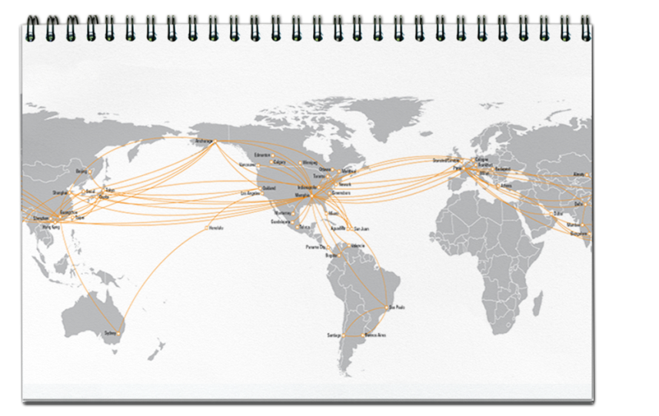


FedEx Brazil – International
Worldwide Linehaul

Slide 9


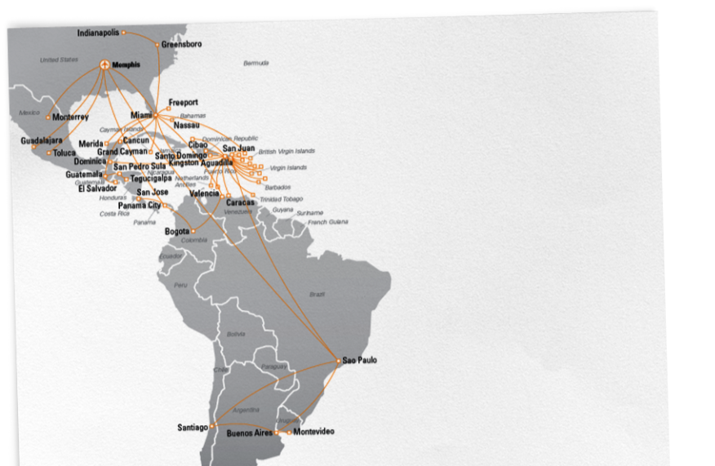
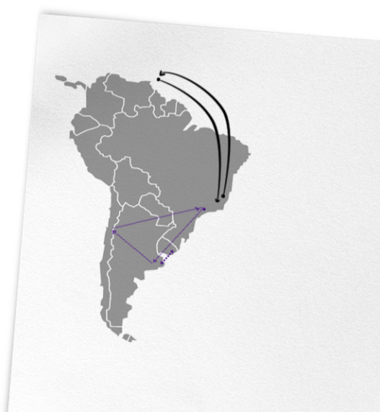


FedEx Brazil – International
FedEx Brazil – International
Latin America Linehaul
South America Linehaul
FedEx MD-11
FedEx 727
Feeder
PRIVILEGED AND CONFIDENTIAL – DO NOT COPY

Slide 10
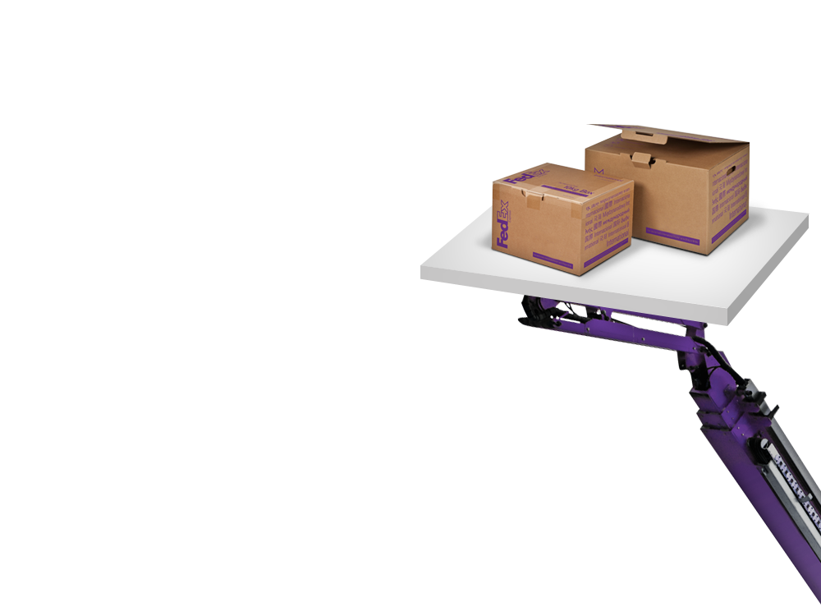
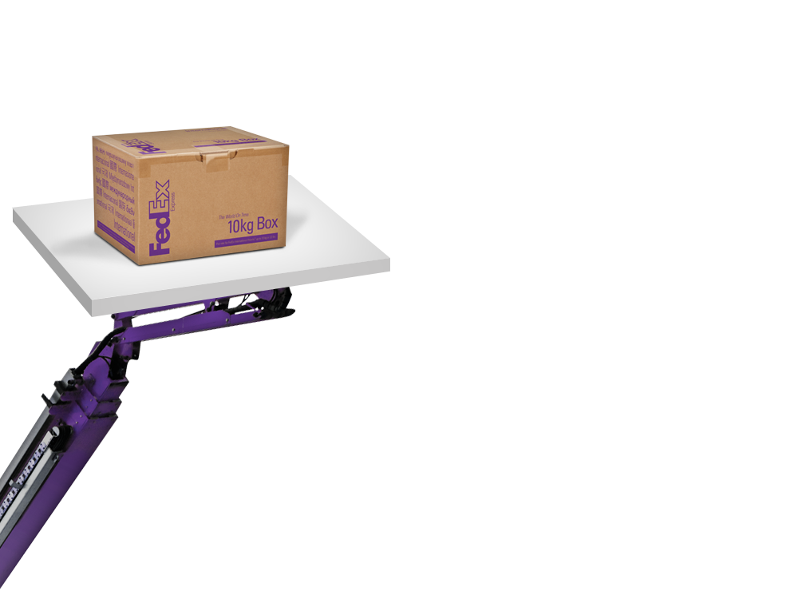




FedEx Brazil - Portfolio
International
Domestic
Exports
Imports
Freight Forwarding
Dangerous Goods
Clearance
Formal (BSO)
Express
Domestic Air
Domestic Ground
Supply Chain & Logistics
LTL
E-commerce

Slide 11
FedEx Brazil – International Portfolio
Door-to-door service, customs clearance, defined transit times, and money-back guarantee
Shipments up to 20.5 kg
FedEx International First®
USA – Delivery by 8:30 a.m.
Europe & Asia – Delivery by 9 a.m.
Shipments up to 68 kg
FedEx International Priority®
Deliveries in 1 to 3 business days
FedEx International Economy®
Deliveries in 4 to 6 business days
FedEx International Priority DirectDistribution®
Door-to-door within 2 to 4 business days*
FedEx International Economy DirectDistribution®
Time-definite, customs-cleared, typically in 4 to 6 business days to the U.S.
Shipments more than 68 kg
FedEx International First Exclusive Delivery®
Customized and flexible service
Positive space – reduced transit time
Pick-up and delivery – exclusive truck
FedEx International Priority Freight®
Deliveries in 1 to 3 business days
FedEx International Economy Freight®
Deliveries in 4 to 6 business days
FedEx International Priority DirectDistribution Freight®
Typically in 4 to 6 business days to most U.S. ZIP codes
FedEx International Airport to Airport
Shipments move on a space-available basis. Nearly all size and weight shipments are accepted

Slide 12



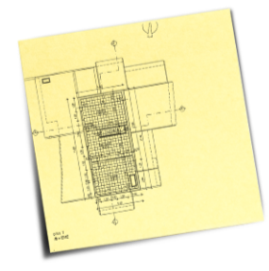

FedEx Brazil – International Portfolio
Clearance: Express and Formal
(BSO – Broker Select Option)
 | Clearance Methods
 | Express | Formal
Product - Description | Documents and samples | Any product
Commercial Destination | No | Yes
Customs Declared Value | US$ 3,000 max | No maximum limitation
Duties and Taxes | 60% - (Import tax Port: Imposto de Importação) 18% - VAT | Duties and Taxes are calculated based on harmonized code (HS)
Point of Clearance | FedEx Warehouse | Government Warehouse
Responsible for Clearance | FedEx | Broker selected by the consignee
Time for Clearance | 98% of shipments cleared on the same day | 1 to 5 business days
When Held by Customs | 1 to 5 business days | 1 to 5 business days
When Held by ANVISA | 1 to 5 business days | 1 to 5 business days
When Held by Agriculture Department | 1 to 2 business days | 1 to 5 business days

Slide 13







FedEx Brazil – International Portfolio
Benefits
Full Track, Trace and Proof of Delivery
Track your shipment at any time by simply logging on to fedex.com/br. Find the location of your shipment or get proof of delivery, including the time of delivery and the name of recipient
Dangerous Goods
Track your shipment at any time by simply logging on to fedex.com/br. Find the location of your shipment or get proof of delivery, including the time of delivery and the name of recipient
Simple Booking Process
Book your pick-up at fedex.com/br or call FedEx Customer Service
Money-Back Garantee
On time express delivery of your shipment, or your money back. The FedEx money-back guarantee demonstrates our confidence that we will meet our delivery commitment
Free Packaging
Provides easy-to-use packaging at no extra cost. Request packaging at fedex.com/br or call Customer Service
Customer Service Support
Toll free 0800 703 3339
Chat
Social Media (Twitter)

Slide 14











FedEx Brazil – International Portfolio
Freight Forwarding
Takes a problem-solving approach to end-to-end shipping services, including customs brokerage, global cargo distribution (even by ocean), and trade facilitation.
Global duty and tax information from WorldTariff™
Full-service customs brokerage
Global ocean distribution
TRANSPORT AND BROKERAGE
TRADE SERVICES
Global air distribution
Trade and customs advisory services

Slide 15

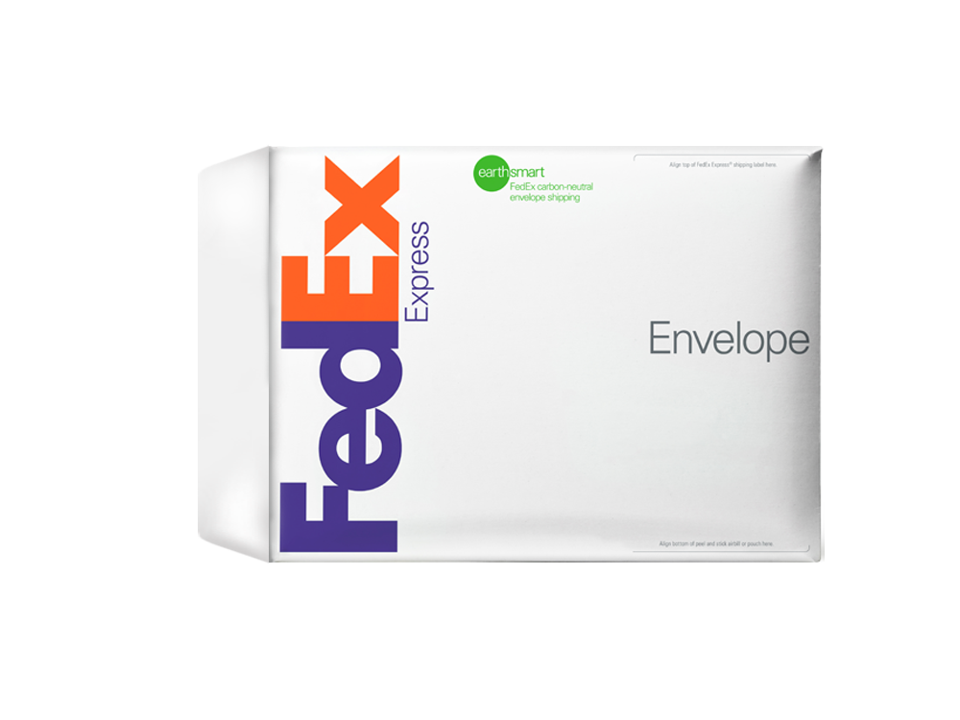
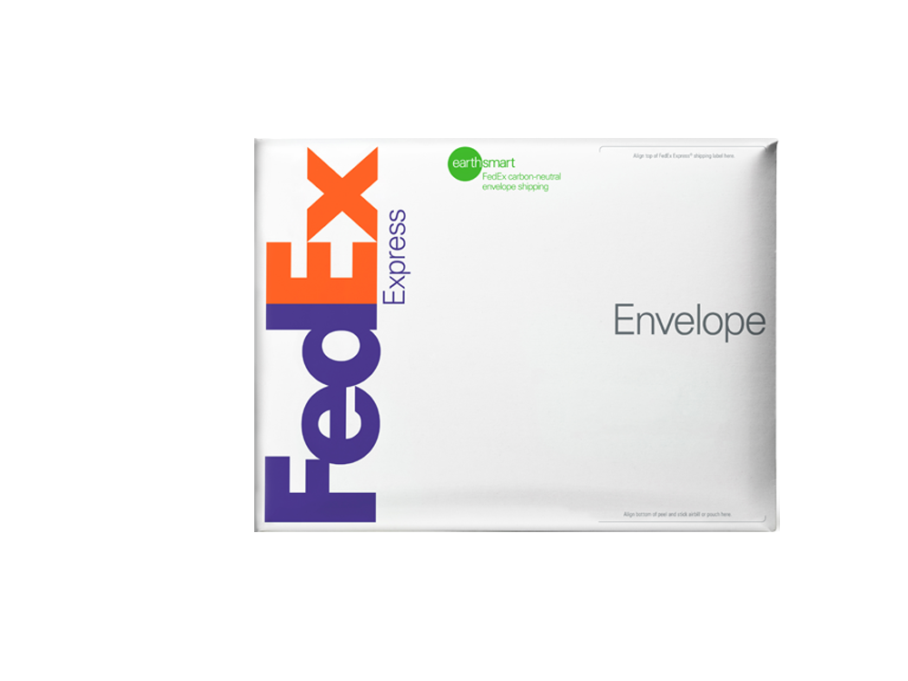

FedEx Brazil – International Portfolio
Freight Forwarding
International Air Freight Forwarding
Outbound and Inbound, special project cargo, part charters
Air Cargo
 | Standard | Premium
Value | Flexible | Faster transit time
Service | Airport-to-airport* (single shipment to single destination, world’s major airports)
Visibility | Shipment to item level** | Shipment to item level**
Transit time | ATA: 3 to 5 days | ATA: 1 to 3 days
Final Mile | Flexible, value-based | Flexible, value-based
Ocean Cargo
FedEx International Direct Economy OceanSM
Value | Flexible
Service | Shipment to single destination worldwide
Visibility | From shipment to item level of detail**
Delivery | Flexible options available via FedEx Trade Networks carrier portfolio
* Pick up and delivery available
** Visibility through Global Order Logistics

Slide 16


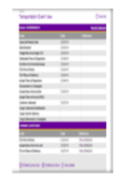





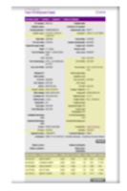

FedEx Brazil – International Portfolio
Freight Forwarding - Benefits
Global Trade Data
Innovative and flexible technology solutions
Web-based interface with 24/7 access up-to-date
Quick Find, Track and Reports
Global Order Logistics
Complete Supply Chain Visibility
A comprehensive logistics management solution providing purchase order control and product-level visibility to your international shipments
Vendor, product, order, shipment data is in one place, easily accessible and normalized for data integrity

Slide 17
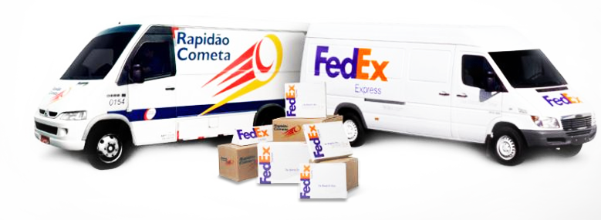
Força Local, Alcance Global
Thanks to this powerful alliance, FedEx will be the only carrier offering time-definite domestic delivery service in Brazil.

Slide 18
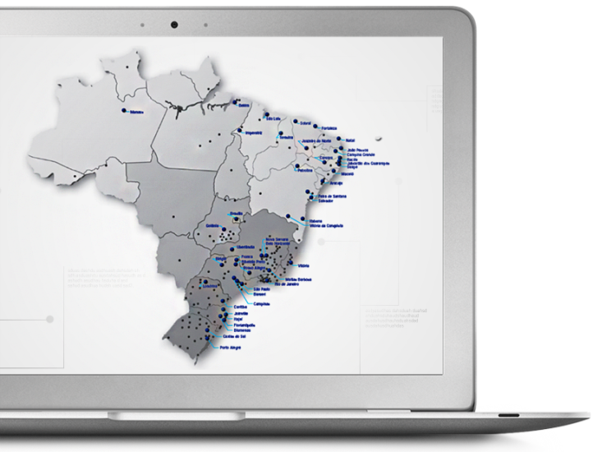
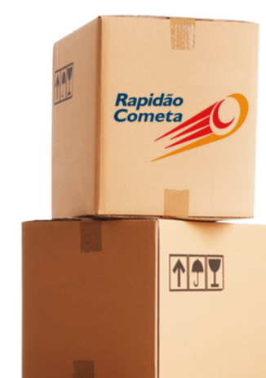
FedEx Brazil – Domestic Coverage
Rapidão Cometa - 3,500 cities and 96% of total territory covered
BRANCH
OPERATIONS AREA

Slide 19
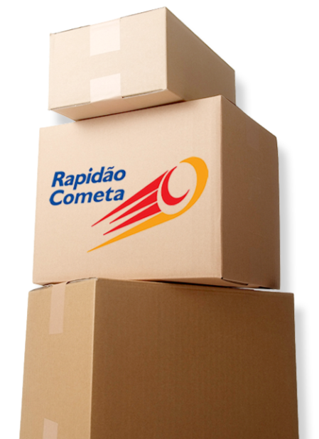








FedEx Brazil – Domestic Portfolio
Air
Ground
Logistics
B2C

Slide 20
FedEx Brazil – Domestic Portfolio
AIRR
We serve all cities in Brazil that have airports, with transit times between 24-72 hours
GROUND
Rapidão Rodo Regional Your freight will be shipped quickly and safely within the same region
Rapidão Rodo Inter-Regional A freight transportation service that connects all regions in the country with the support of a network of terminals and fleet vehicles, with the additional benefit of extensive knowledge of the specific features of each region
Rapidão 1a Hora Inter-Regional A road freight express service for small consignments with high added value, it is also Rapidão Cometa’s fastest ground transportation service
Aéreo Colo a Colo Rapidão Cometa’s most urgent service
Aéreo Pequenos Volumes The best option to ship small packages from 100 grams to 8 kgs
Aéreo Expresso Transportation for shipments that need to arrive at their destination quickly and safely
Aéreo Tradicional For shipments with a delivery lead time of up to 2 business days for state capital cities and up to 3 business days for all other locations

Slide 21
FedEx Brazil – Domestic Portfolio
LOGISTICS
B2C
Capacity to operate consignments with a minimum weight of 100 grams, such as CDs, DVDs, and books
Special rates for different weight ranges
Logistics planning development: storage, distribution, kitting, reverse logistics, and customer information service
Exclusive home delivery network
Staff dedicated to home delivery
Knowledge and experience in relationship with home delivery recipients
Ability to combine Rapidão Cometa’s different transportation service modes
Full logistics services tailored to the needs of every step in the supply chain process
Operation at your premises or at the Rapidão Cometa’s terminals
Nationwide coverage
Customized projects according to specific customer needs
Specialized teams for the development of individual projects
Study of tax load impact on logistics solutions proposed
Service assessment through performance indicators

Slide 22
FedEx Brazil – Domestic Features & Benefits
Features
Local, state, regional, and national ground transportation
Comprehensive services
Available for TL or LTL
Shortest delivery lead times in the market
No weight limits for goods to be carried
End-to-end process visibility
Satellite-enabled monitoring system 24 hours a day, 7 days a week
End-to-end risk management
Benefits
Fast Deliveries
Precise Deliveries (consignee present at delivery)
Proactive eletronic notification – automatic e-mails to customers
Fast and reliable information
Flexible operation: home delivery, extended hours, etc.

Slide 23






We connect the world in responsible and resourceful ways
At FedEx,
we recognize that our impact is greater than the services we provide
We are committed
to being a great place to work, a thoughtful steward of the environment and a caring citizen in the communities where we live and work
We are passionate
about sustainably connecting people and places and improving the quality of life around the world

Slide 24
FedEx Brazil – Contact
Ricardo Araujo
Comercial MD – Rapidao Cometa
Phone: 55 (11) 2463 7370
Email: ricardoaraujo@rapidaocometa.com.br
For more information contact your local FedEx Sales Representative or visit (Becca, can you give me the link for the Brazil landing page please?)

Slide 25

BRAZIL
WORLD

Slide 26
声明：
所有的版权属于原有公司，文件均来自公开渠道
此文件仅供学习使用，任何人不得进行以此为商业目的的行为
如有疑问，请立即删除
学习世界五百强和咨询公司PPT课程请访问如下网站搜索：“司马懿”
百度传课：司马懿PPT学校
https://www.chuanke.com
网易学堂：司马懿PPT学校
https://study.163.com
知乎： 司马懿PPT学校
https://www.zhiu.com

